Slide 1
THE EMOTIONALLY INTELLIGENT LEADER
“The Missing Ingredient for Leadership Success”

Slide 2
According to David R. Smith: “Emotional Intelligence is a set of skills that define how effectively we perceive, understand, express reason with our own emotions, and the emotions of others”

Slide 3
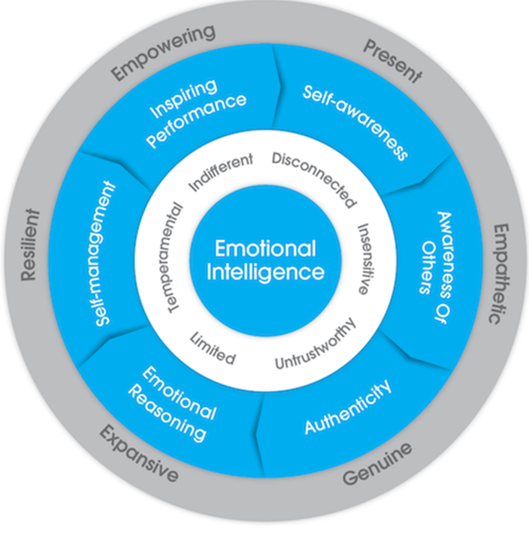
THE GENOS MODEL OF EMOTIONAL INTELLIGENCE LEADERSHIP
Inner circle –
unproductive leadership
being states
Outer circle–
productive leadership
being states

Slide 4
KEY CONCEPTS
Emotions influence decisions, behaviour and performance, productivity and unproductivity
There is a direct link between the way people feel and the way people perform at work
In high performing organizations people feel significantly more engaged, cared for , valued, proud and motivated than those in low performing organisations. Conversely, in low performing workplaces people feel significantly more fearful, stressed, disempowered and unconcern.

Slide 5
KEY CONCEPTS continued
Leadership is fundamentally about getting others to perform, to do things effectively and efficiently.
Leaders need to be skilled at identifying, understanding and managing emotions in themselves and others, to help drive the best decisions, behaviour and performance.

Slide 6
KEY CONCEPTS continued
Research has proven that a leader’s emotional intelligence is key to their capacity to facilitate emotions in themselves and others that drive high performance and employee engagement.
Applied in leadership, emotional intelligence is about how intelligently you use emotions to get positive results.

Slide 7
COMPETENCY DEFINITIONS
Self Awareness: Self-Awareness is about being aware of the behaviour you demonstrate, your strengths and limitations, and the impact you have on others
Awareness of Others: Awareness of others is about noticing and acknowledging others, ensuring others feel valued and adjusting one’s own style to best fit with others

Slide 8
COMPETENCY DEFINITIONS continued
Authenticity: Authenticity is about openly and effectively expressing oneself, honouring commitments and encouraging this behaviour in others.
Emotional Reasoning: Emotional reasoning is about using the information in feelings (from oneself and others,) and combining it with other facts and information when decision-making.

Slide 9
COMPETENCY DEFINITIONS continued
Self Management: Self-Management is about managing one’s own mood and emotions; time and behaviour; and continuously improving oneself.
Inspiring Performance: Inspiring Performance is about facilitating high performance in others through problem solving, promoting, recognizing and supporting others’ work

Slide 10
EMOTIONAL INTELLIGENCE IN SUMMARY
Emotional Intelligence involves a set of skills that define how effectively you perceive, understand, reason with and manage your own and others’ feelings
E1 Competency Emotional Self Awareness | Definition | Workplace Outcomes
 | The skill of perceiving and understanding your own emotions | The capacity to identify and understand the impact of one’s own feelings are having on decisions, behaviour and performance at work Greater self-awareness

Slide 11
EMOTIONAL INTELLIGENCE IN SUMMARY continued
E1 | Definition | Workplace Outcomes
Emotional Awareness of Others | The skill of perceiving and understanding others emotions | Greater understanding of others and how to engage, respond, motivate and connect with them Interpersonal effectiveness
Emotional Expression | The skill of expressing your own emotions effectively | Creating greater understanding amongst colleagues about yourself Creating trust and perceptions of genuineness amongst colleagues

Slide 12
EMOTIONAL INTELLIGENCE IN SUMMARY continued
E1 | Definition | Workplace Outcomes
Emotional Reasoning | The skill of utilising emotional information in decision-making | Enhanced decision-making where different types of information are gathered and processed Greater buy-in from others in decisions that are made

Slide 13
EMOTIONAL INTELLIGENCE IN SUMMARY continued
E1 | Definition | Workplace Outcomes
Emotional Self-Management | The skill of effectively managing and controlling your own emotions | Improved job satisfaction and engagement Improved ability to cope with high work demands Enhanced productivity and performance Improved emotional well-being The capacity to think clearly in stressful situations The capacity to effectively deal with situations that cause strong emotions

Slide 14
EMOTIONAL INTELLIGENCE IN SUMMARY continued
E1 | Definition | Workplace Outcomes
Inspiring Performance | The skill of facilitating high performance in others | The capacity to generate a positive and satisfying work environment for others The capacity to deal with workplace conflict effectively The ability to recognise, promote, and support others’ work

Slide 15
C. William Iton University Registrar

