Slide 1
Tertiary students’ perception of “Quality” Education – Processes vis-à-vis Product: A Case Study of a Jamaican University
La-Cresha Gordon-Brydson, University of Technology, Jamaica

Slide 2
PRESENTATION OUTLINE
Introduction and Background
Research Objectives & Questions
Literature Review
Research Methodology
Discussion of Findings
Conclusion

Slide 3
Introduction
Quality is regarded as a complex, problematic, contested and multidimensional concept involving many stakeholders both internal and external to the institution. (Elken & Stensaker, 2018)

Slide 4
Stakeholders of Quality IN HIGHER education
Quality in HE
Students
Governments
Teaching & Non teaching staff
Employers
Funding agencies
Accrediting Bodies
Certification Bodies

Slide 5
INTRODUCTION
Philosophical View
Definition
Quality
Quality as absolute
Excellence
Quality as relative
Fitness for Purpose
Value for Money
Return on Investment

Slide 6
BACKGROUND
Literature suggest that for too long, evaluations of quality in education have focused on other stakeholders interpretations.
There must now be a shift from the traditional focus other stakeholders interpreting quality by their own standards to focus primarily on what students perceive as their needs for a quality higher education experience.

Slide 7
BACKGROUND
As the national University, UTech, Ja.’s core business revolves around students, teaching and learning, research and service. Faced with strong competition, there is the need for ongoing evaluation of the Institution’s products and processes in order to create a strong competitive advantage.
This study investigates undergraduate students’ perception of their higher education experiences in one faculty at UTech, Ja., focusing on the ways in which they perceive “quality” in the academic and administrative processes, vis-à-vis the educational product.

Slide 8
RESEARCH OBJECTIVES & QUESTIONS
To determine how students in enrolled in a course of study in the selected faculty define quality education.
Obtain a better understanding of what aspects of the university experience students place value on in their determination of quality university education.
What does quality education mean to you?
What aspects of the university experience are considered in your determination of quality education and how important are they?
How well has the Faculty been able to respond to these “quality” indicators?

Slide 9
DELIMITATIONS & LIMITATIONS OF THE STUDY
This study was limited to one faculty within the University.
The researcher considers this to be a preliminary study. It is believed that the inclusion of more focus group sessions or a greater number of participates will further enrich the data.

Slide 10
METHODOLOGY
Qualitative research; case study approach
Purposive sampling
The sample population - nine (9) who were enrolled in the 2019 summer session in a select faculty at UTech, Ja.
Data collection methods - focus group discussion, interviews, document reviews
Ethical considerations observed.

Slide 11
LITERATURE REVIEW
Quality education experience as perceived by students:
Teaching & Learning experience
Curriculum content ; high interaction between learner& facilitator; acknowledgement learning styles in content delivery; Timetabling and sufficient contact hours ; reasonable class sizes; contact outside of class time; Course structure; mode of delivery; relationships
Availability of physical resources
reliable internet; sufficient library resources and learning spaces; computers; fitting accommodation
Social & emotional support systems
pleasant learning environment; opportunities to interact with other students and faculty through societies and clubs, institutional activities and other social opportunities

Slide 12
LITERATURE REVIEW
Quality education experience as perceived students:
Employability
Availability of programmes that promoted work-readiness and provided opportunities for interaction with industry – job attachments, mentorships, work expereince, internships
Value for Money
Understanding of how tuition fees are utlised - how teaching/ course offerings are structured; creating schedules that are flexible/affordable enough; how contact hours are determined etc.; rejection of passive teaching

Slide 13
DISCUSSION OF FINDINGS
RQ1: Definition of quality in education
“That which prepares students, through the acquisition of knowledge, skills and competencies, to function effectively beyond the classroom; normally the workplace”
Additional criteria
Must meet industry standards.
Must be recognized locally and internationally.
Must be able to practically apply and raise the quality of life.
Must raise the value of the worker, and;
Must compare well with international best practices.

Slide 14
DISCUSSION OF FINDINGS
RQ2: Aspects of the University Experience that are considered in the Determination of Quality Education and Their Importance
1. The Teaching and Learning experience
The competence/expertise of lecturers/ facilitators.
A demand for lecturers who utilised varying methodologies/ teaching styles and technology to engage a class of diverse learners.
The demonstration of soft skills by lecturers.
Adequate and timely feedback.
Accessibility of lecturers, particularly those employed on a part-time basis.

Slide 15
DISCUSSION OF FINDINGS
RQ2: Aspects of the University Experience that are considered in the Determination of Quality Education and Their Importance
3. Partnerships
With other HEIs - greater opportunities for exchanges, sharing of resources.
with industry for vocational practice.
5. Non-academic support services
Customer service.
Involvement with student union, clubs and societies.

Slide 16
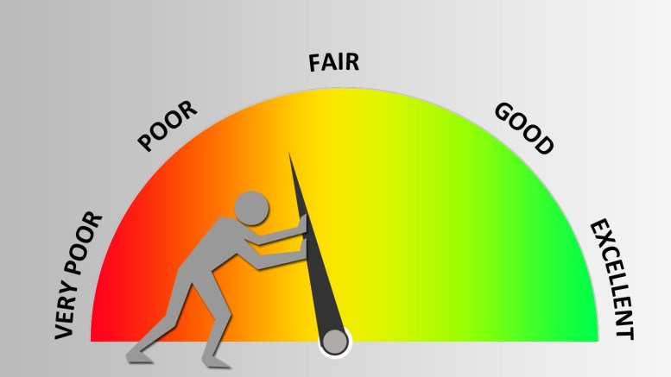
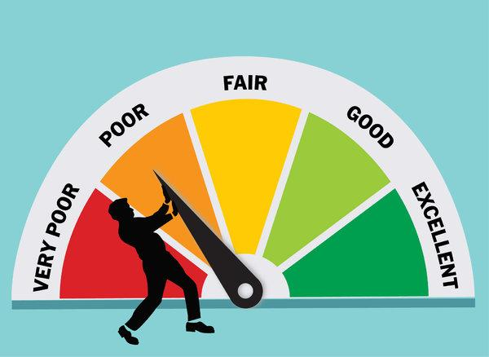
DISCUSSION OF FINDINGS
RQ3. Faculty Response to Quality Indicators
Favourable ratings: course content, overall learning, course affordability, being able to relate to lecturers, relevance of the programmes (use of guest lectures, seminars, conferences and workshops , field trips and Co-operative Education.
Unfavourable ratings: administrative services, particularly Admissions and Accounts;
Faculty’s response to feedback received on the Instructor Module Evaluations (IME) forms.

Slide 17
STUDENTS’ RECOMMENDATIONS FOR IMPROVEMENT
Lecturers should be mandated to attend professional development workshops regularly.
The Faculty/ University should provide mandatory and on-going customer service training for all staff who interface with students.
The Faculty should encourage partnership with more industry persons to serve as mentors/ career advisors. They can also assist lecturers in the delivery of highly areas within a programme.
The Faculty should consider removing or amalgamating modules with overlapping content.

Slide 18
STUDENTS’ RECOMMENDATIONS FOR IMPROVEMENT
Students should be made aware, in a more structured way, how concerns as articulated on the Instructor Module Evaluation forms, are being addressed.
All lecturers should be mandated to set up virtual offices where they could be reached and feedback received within reasonable time.
The Faculty/university should conduct regular student satisfaction surveys and;
The Faculty is to act in a timely manner to address issues over which they have control.

Slide 19
CONCLUSION: COMPARISON OF LITERATURE AND FINDINGS

Slide 20
CONCLUSION
The most important inputs, consistent with similar studies around the globe, have been the various activities associated with teaching and learning followed closely by accessibility to pertinent and current technologies.
Considerations of cost effectiveness, affordability and flexibility in discussions of quality in education required greater analysis by administrators who are being responsive to students’ needs.
While institutional policies exist that support institutions’ quality assurance systems, the format and timing of feedback need to more effectively managed so students can become more confident that their concerns are being adequately addressed.
On-going professional development and meaningful recognition of teaching and administrative excellence must be considered essential faculty response in enhancing students’ perception of quality education.

Slide 21
END OF PRESENTATION

Slide 22
THE TEACHING AND LEARNING EXPERIENCE
The most valuable lecturers are those who have a good mix of industry experience, knowledge of the area they are asked to teach, the “know how” to teach, and of course, allow students to use their creativity
The competence/expertise of lecturers/ facilitators.
Pedagogical training
Ability to offer academic and career advisement
Impact of language of language barrier
Rose W., student

Slide 23
THE TEACHING AND LEARNING EXPERIENCE
“A’s are not easy to come by especially at UTech, you have to put in a lot of effort but when the lecturer makes it as interactive, it seems like “A” is at your fingertips just like that!”
A demand for lecturers who utilised varying methodologies/ teaching styles and technology to engage a class of diverse learners.
Emphasis placed on the different learning styles
Ability to use related technology – (equipment &software)
Expanding the use of Moodle
Chavez, student

Slide 24
THE TEACHING AND LEARNING EXPERIENCE
The demonstration of soft skills by lecturers. Required lecturers who:
demonstrated patience, interest in their learning, empathy and willingness to offer mentorship
Demonstrated the ability to communicate or interact with students
“The biggest impact on my educational experience has been my lecturers and how they interact with the students. I believe you must be able to interact freely with lecturers to aid in learning. Some lecturers are unapproachable; you are afraid to speak to them and to ask questions that
would enhance your
understanding and could
possibly result in a better
grade overall.”
Jane Doe, student

Slide 25
THE TEACHING AND LEARNING EXPERIENCE
Adequate and timely feedback.
“They (students) go into an exam without knowing the particular grade. If you don’t know the grades then you don’t know if you need to put in extra effort. Some persons have their goals and if they know they are doing well enough in a particular module, they can devote their study time elsewhere for finals.”
- Jessica, student

Slide 26
PARTNERSHIPS
with industry for vocational practice
“No other university or faculty gives the amount of industry practice that this faculty’s students get; that is just my opinion… When you talk about practice, work experience, workshops. I heard this quote on TV and I think it applies; they make us practice until we cannot get it wrong!”
Chavez, student

Slide 27
NON-ACADEMIC SUPPORT SERVICES
a) Customer service
“It should be about caring about the students and not just wanting to take our money. They know that they are in a position to help you move from one point to the other and they drag their feet on the process.”
Jessica, student

