Slide 1
College of Business and Management
University of Technology, Jamaica

Slide 2
“Social Media and Mental Health in the Digital Age”
ACHEA Conference 2019
NEW TIMES, NEW APPROACHES TO HIGHER EDUCATION
Presenters: Paul Golding, Ramoné Peck, Patricia Thomas

Slide 3
Presentation Outline
This presentation will cover:
Objective
Purpose of the Study
Methodology
Findings
Discussion
Recommendations
Question and Answer

Slide 4
Objective
Social media impact on the mental health of teenagers and young adults.
How teenagers and young adults use social media
Make recommendation on social media usage by teenagers and young adults.
Suggest ways to promote wellbeing and resilience in the digital age.

Slide 5
Purpose of the Study
The data from the study will be used to aid university administrators to develop strategies to identify, treat and promote healthy mental health attitudes and behaviours for current and prospective students in higher education institutions.

Slide 6
Methodology
Questionnaire Development
Data Collection
Focus groups
- Pre-university Students
- Current University Students
Demographics

Slide 7
Findings

Slide 8
Internet/Phone Usage
Jamaican students are highly connected. 95% of students accessed the internet on a cell phone, tablet or other mobile device, at least occasionally.

Slide 9
Most Popular Social Media Platforms for Users Between
13-18
SNAPCHAT 52.1%
YOUTUBE 51.2%
TWITTER 20.8%
INSTAGRAM 66.1%
FACEBOOK 58%
WHATSAPP
84.2%

Slide 10
Internet/Phone Frequency of Usage
The study showed that the frequency of usage of the internet among students was high % of cases
Frequency of Internet Usage | Sex |  | Total
 | Boy | Girl
Daily | 48% | 50% | 49%
Weekly | 6% | 5% | 5%
Almost Constantly | 15% | 15% | 15%
About once a day | 4% | 3% | 4%
Several times a day | 12% | 15% | 14%
Once a week | 4% | 3% | 3%
Several times a Week | 7% | 6% | 6%
Less often | 5% | 5% | 5%

Slide 11
Hours of Usage
Hours spent on Technology | Sex |  | Total
 | Boy | Girl
None | 6% | 4% | 5%
1-3hrs | 26% | 28% | 27%
4-6hrs | 24% | 22% | 23%
7-9hrs | 13% | 14% | 14%
10hrs or more | 31% | 32% | 32%

Slide 12
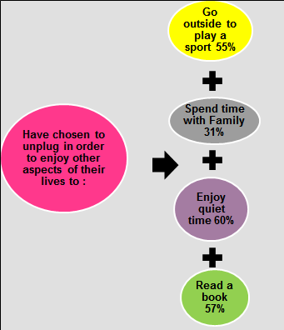
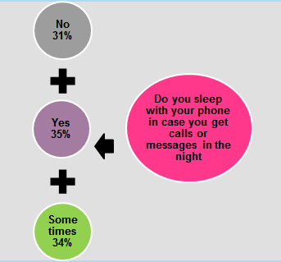
Connected at All Times
This section examines the extent to which students feel the need to be connected at all times

Slide 13
Cyberbullying
The data indicates that four in ten, (40%) of Jamaican students have experienced cyberbullying with both boys and girl experiencing it equally.
The Main Means of Bullying
Calling someone a name 75%
Posting an embarrassing photo 33%
Spreading rumours 19%
Threaten to physically hurt someone 28%

Slide 14
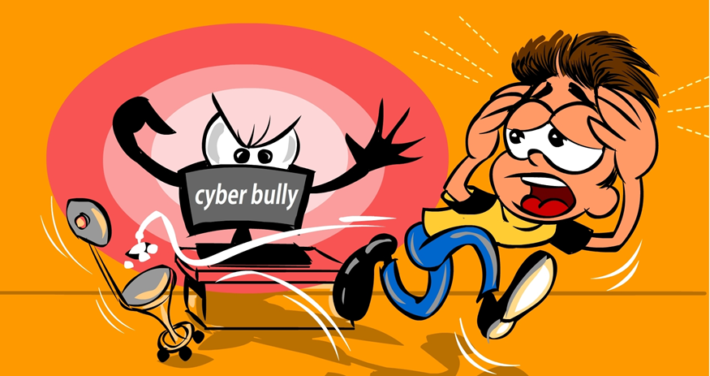
Cyberbullying Cont’d
Students response to cyberbullying was primarily non-confrontational. The techniques used included:
blocking the persons (60%)
ignoring the persons (40%)
a significant minority would confront the person (35%)

Slide 15
Cyberbullying Cont’d
- The incidence of online threats is low with 75% of students never being threatened and for those who have received threats 66% don’t take them seriously.
- If and when students receive threats they are most likely to ask their parents for help (47%) or ignore it 34% or ask a friend for help 29%.

Slide 16
Sexting/Nudes
The study examined students’ behaviours surrounding sexting by asking a series of questions in relation to sending and receiving nude messages.
The results indicate that over 50% of the students across grade levels received sexy or nude photos from someone. These students, in turn, partake in forwarding or sending nude or sexy photos to other students. This observation was approximately constant across grade levels except for grade 12 students who were least likely to forward a sexy or nude photo to someone.
Girls are more likely to receive sexy or nude photos than boys, while boys are more likely to send nudes of themselves.
The data suggest that while forwarding nudes happens it is generally considered taboo to forward these messages, and the incidence may not be as common as adults may think.

Slide 17
The Internet as a Source of Data on Mental Health and Sexuality
An analysis on pre-university students age 13-18 revealed that 32% of boys and 35% of girls use the internet to search for information on mental health issues . The other areas that students search for information was about sexuality 26%, relationship problems,40% and physical health 47%. It also indicates that as students get older the propensity to investigate these issues, apparently on their own, increases.
Response | Pre-University Students
 | Grade 7-13 , Age 13-18 |  |  |  |  |  |  | Total
Mental health issues | 24% | 27% | 33% | 42% | 40% | 39% | 50% | 34%
Sexuality | 15% | 16% | 27% | 38% | 29% | 39% | 35% | 26%
Relationship problems | 30% | 33% | 39% | 51% | 41% | 53% | 60% | 40%
Physical health issues | 35% | 40% | 44% | 52% | 55% | 59% | 68% | 47%
Use the Internet to Find Information by Grade.

Slide 18
The Internet as a Source of Data on Mental Health and Sexuality
Students were asked if social media created stress. Approximately 35% gave a yes response. There were no discernible differences in the stress-related response across sex or age group.
Table 17: Social Media Created Stress: Sex and Age Group
Response | Sex |  | Age Group
 | Boy | Girl | 13-15 years old | 16-18 years old
Yes | 33% | 36% | 34% | 37%
No | 67% | 64% | 66% | 63%

Slide 19
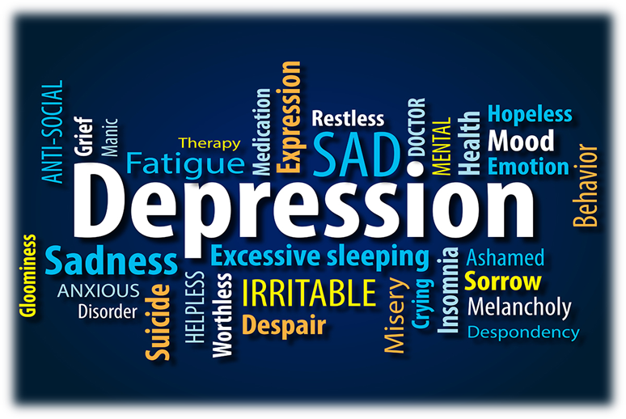
Depression/Anxiety and Suicide
The mental health effects on social media users

Slide 20
Depression/Anxiety and Suicide Cont’d
University students indicated that their main source of depression/anxiety and suicide is caused by:
Main Source of Depression/ anxiety and suicide
Confusion on a number of issues including their sexuality
Studying and balancing work
Financial Constraints (having to finance own education or little support from family
Relationship issues with partners
Treatment from parents and family members

Slide 21
Depression/Anxiety and Suicide Cont’d
The focus group held with university students revealed that 57% of the participants contemplated suicide on a number of occasions. They explained that they did their research on suicide and know exactly what to do for a peaceful and quick death. 43% of the group have never considered suicide.

Slide 22
Discussion
Positive Effects of Social Media on Teenagers and Young Adults
Socialization
Enhance Communication
Learning Opportunities
Access to Health Information
Helps to avoid boredom

Slide 23
Discussion Cont’d
Negative Effects of Social Media on Teenagers and Young Adults
Cyber-Bullying
Depression and anxiety
Sexting
Addiction
(fear of missing out)
Suicide

Slide 24
Discussion Cont’d
Addiction
Cyberbullying
Sexting
Depression/Anxiety and Suicide
Internet as a source of information on Depression and Mental Health
- Society of mental health (University student not aware of free access to the Counselling Unit
- Sexuality
- Physical Health

Slide 25
Recommendations
Pre-entry University Students/Institutions
The data indicates that there is a need to improve digital literacy among teens and young adults. To accomplish this, parents, teachers lecturers and administrators need to be digitally literate themselves.
Educate students about acceptable and non-acceptable forms of behaviour on social media websites.
Students should understand that sexting/Nudes is a risky sexual behaviour that can result in shame, anxiety depression ridicule and other mental health issues. They should understand that pressuring their partners to send nudes is unacceptable.
Students need to be careful who they accept or let into their cyberspace.
Teach students how to handle and respond productively to cyber- bullying. Encourage them not to respond to negative tactics used by cyber bullies, as it could possibly lead to suicide.

Slide 26
Recommendations Cont’d
Young Adults in University
Focus should be placed on the advertisement of the counselling unit at universities or higher education institutions, so more students are aware of the existence and accessibility.
There should be forums to highlight issues affecting students in university. This would encourage a system of openness and provide support and reassurance for students once they know it is available.
Higher education institutions can target sensitive areas in open discussion and encourage students to discuss them with counsellors or health professionals privately.

Slide 27
Recommendations Cont’d
Other Recommendations
Encourage teens and young adults to keep personal information private off the internet.
There should be initiatives to help promote empathy among students.
The main focus of the research is the need to improve digital literacy among teens and young adults. To accomplish this parents, teachers and administrators need to be digitally literate themselves.

