Slide 1

Higher Education in the Caribbean and Latin America
Adriana LaValley

Slide 2
Outline
Diagnostic of Higher Education in Latin America and the Caribbean (LAC)
Challenges: expand access and control quality
Conclusions

Slide 3
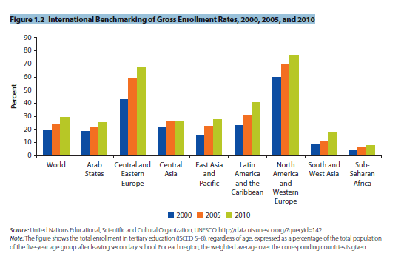
Global Perspective
Source: Higher Education at a Crossroads, p. 49. World Bank
Notes:
Diagnostic of Higher Education:
Since 2010, higher education has experienced a dramatic change as enrolments have increased significantly across the world.
LAC has had one of the largest increases, with enrolment moving from 18% in 1996 to 44% in 2014.
As the graph shows, LAC has higher enrolment than the world average but lags behind Central and Eastern Europe and North America and Western Europe.
Why is expansion of HE important?
As more people have access to higher education, they have the opportunity to enhance their skills and knowledge and thereby increase their productivity. Our countries need more highly educated workers (referred to as human capital by economists) to advance economically and socially. Higher education can give people more social mobility and can reduce inequality (for example between rich and poor, or between urban and rural areas).

Slide 4
Expansion of Higher Education enrolments continues, due to private and public efforts
  Gross Enrolment rates in post-secondary Education (%)
Source: IDB Calculations based on Household Surveys.
Note: The Reference year for Mexico is 2004, for Brasil 2001, and for Peru 1998. For Chile, the comparison year is 2013.
Notes:
Compared to the earlier slide that showed changes in enrolment across the globe, this slide focuses on Latin America, where we see dramatic growth in HE in countries such as Brazil (from 11% in 1994 to 39% in 2014) and Chile (from 26% in 1994 to 61% in 2014)
This dramatic expansion in access is due to both public and private efforts. In many countries there was an expansion of private universities that contributed to the increased spaces in higher education. As we mentioned in the last slide,
this expansion is very positive because more people with more qualifications and knowledge contribute to the economic and social development of our countries, that is, their productivity.
I’m sure you’ve noted that the Caribbean countries are not represented in this graph. When preparing this presentation, we found that data for the Caribbean was not easily available. We included Caribbean data whenever possible, but one strong message coming out of the presentation is that it is very important for this region to document your efforts and achievements in HE so they can be included in LAC statistics.

Slide 5
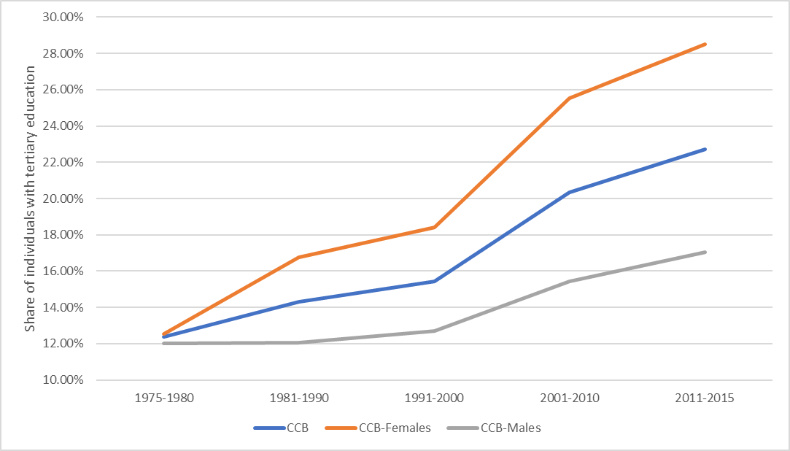
Caribbean:
10% point increase in Enrolment in Higher education among age groups [since 1991] but gender gap persists
Source: IDB/CCB calculations 2016
Population weighted average for CCB countries
Countries included: Jamaica, Barbados, Suriname, The Bahamas, Guyana, Trinidad and Tobago
Age cohorts by birth year
Notes:
The same pattern of increased enrolment holds true for the Caribbean.
We can see that over time, more people have access to higher education.
If we look at ‘age cohorts’” we can see that young generations (those born from 1991-2000 and forward) have increasingly more access to HE.
What is interesting is that more women have enrolled in higher education at higher rates than men.

Slide 6
More students access Higher Education who traditionally were excluded, but gaps continue to exist
Gross enrolment rates in Higher Education among 18-23 year olds,
by quintile of family income, 1998 and 2014 (percentage)
Source: IDB own calculations, Household surveys.
Notes:
In addition, when we look at who gained access to higher education in the last decades, we can see that HE could contribute to more equity and social mobility.
As we can see from the slide, over the years, students from quintiles 1 and 2 (students from the poorest families) were able to gain more access to higher education over time, although quintile 5 students (from the wealthiest families) continue to have much higher rates of enrolment.
An interesting case is Argentina where quintiles 1 and 2 jumped from 25% in 1998 to 62% in 2014 because the government made a special effort to make higher education more accessible to lower income students.
And in Honduras, there was little increase among the poorer students, but a huge jump from 6% to 66% in the same time period because there was a large expansion of private institutions which were accessible only to wealthier students.

Slide 7
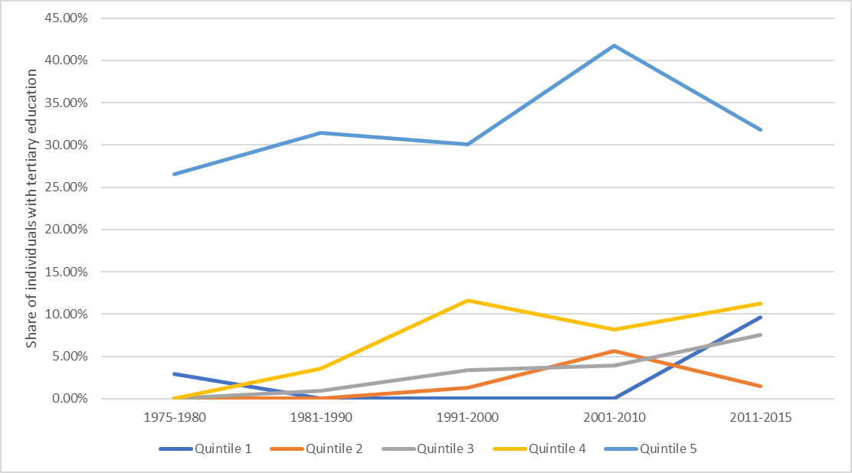
Caribbean:
Enrolment in Higher education by quintiles
Jamaica only
Source: IDB/CCB calculations
2015 Jamaica Survey of Living Conditions
Notes:
To see if a similar pattern exists in the Caribbean (that is, more students access HE who were traditionally excluded), we have data from 2015 Jamaica Survey of Living Conditions that also shows that students born from 2001-2010 and forward from the poorest families (quintile 1) gained more access to HE (no clear explanation for quintile 2) but it still only reaches 10%. This is low compared to the rates of enrolment of this quintile in the other LA countries.
It also is very clear that Quintile 5 (the richest) in Jamaica maintains the highest rate of enrolment in HE, although it also is very low compared to other LA countries (under 35% compared to most countries above 70% by 2014 in the previous graph).
The fact that the 4 and 5th quintiles have less access to HE translates into a considerable loss of capacity and talent in the country. The country loses possibly an engineer, doctor, technician, IT professional, economist or writer who cannot develop all his/her talents. And so the region has lost another potential VS Naipaul or “Sir Arthur Lewis”

Slide 8
It still pays to complete Higher Education compared to secondary education only
Source: Arias et al., 2017
Notes:
This shows that with higher education, you can earn more, that is, in general the rate of return to higher education is positive.

Slide 9
High dropout rates in Higher Education
Drop out Rate by program (pre-degree) in LAC, 2005
Source: IESALC (UNESCO) and SNIES for Colombia; Salmi (2013). Category Other LAC countries includes a simple mean for Venezuela, Uruguay, Bolivia and Dom Rep.
Notes:
So we have seen that more students are enrolling in HE. But there are some concerns regarding who has access, how well incoming students are prepared for higher education, and how well the HE programs prepare them for the world of work. We have data that shows troubling tendencies.
Here, statistics show that students enroll but they don’t all finish their degrees.
This information is troublesome as it clearly shows that quite a high percentage of students do not complete their programs.
Dropout can be explained in different ways:
Students may drop out because their secondary school program did not prepare them well enough for tertiary studies and they can’t keep up.
Dropouts also could indicate that the quality of the program was not very good; or students realize they will not find employment in their chosen field, or they can no longer afford the cost of the studies.
Dropping out can also mean that the young person gets a better understanding of what s/he wants to do and finds a field/area that is a better match. One solution to this problem could be the offering of shorter or more flexible programs to allow students to make mistakes or try things before committing to a longer program.
Dropouts have consequences:
Individuals lose earnings by studying rather than working.
Unfinished studies come at a cost to society as well since many students go to university for free or for subsidized rates provided by the government (through taxes), which means that money is lost forever on dropouts (many of whom leave in the 3rd or 4th year) when they could have been used for another person who might have finished the program.

Slide 10
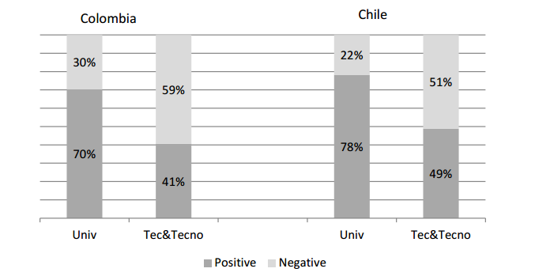
Many students are experiencing low or negative returns
Share of Higher Education Graduates with Positive/Negative Returns
Source: González-Velosa et al. 2015
Notes:
Although we saw earlier that higher education has higher returns, it does not apply in all cases. We see here that even those who finish their degrees are not necessarily earning more money, which could speak to the quality of the programs and the relevance of the fields of study.
In a publication from 2015 on Colombia and Chile, a significant share of students enrolled in both university or technical institutions exhibit negative returns from their investment, highlighting the importance of information about programs (so students can choose well) and quality assurance mechanisms (to ensure high quality programs).
These findings are worrisome because students make sacrifices in money and time to attend school with the assumption that they will be better off.

Slide 11

THE REAL CHALLENGE: How to expand Access while controlling for Quality?
Notes:
For the rest of the presentation, I will talk about ways to expand access while controlling for quality. I will touch on three areas:
Different financing mechanisms
Better information to help potential students make better choices
More engagement and better partnerships with the private sector to ensure study programs are relevant

Slide 12
Financing of Higher Education
Supply side subsidies:
Currently, all LAC HE systems receive direct financing from the government
Limited use of innovative instruments:
  Competitive funds: promote quality improvements and build capacity in tertiary education (FOMEC in Argentina and MECESUP in Chile).
  Performance contracts (widely used in France, Finland, Denmark). In LAC, in Chile and Costa Rica. In Chile, represented between 5 and 30% of total annual budget.
  Voucher-type payments to institutions (linked to inputs or performance based outputs). Ex: Aporte Fiscal Indirecto in Chile contingent on “number of high quality students”
Notes:
Currently all HE systems in LAC receive funds from the government, that is direct financing. These budgets can be negotiated or established ad-hoc.
There is little use of innovative financing instruments such as assignment of (partial) public funds to institutions based on performance criteria/or incentives to quality (OECD, 2008) . Here we see a few examples.
These financing instruments are based on performance criteria or incentives to quality. Under these schemes, the institutions would be required to disseminate information on graduation and drop-out rates as well as employment rates by field of study, continuation to graduate school, internships, etc. The use of these financing instruments would encourage elimination of ineffective or irrelevant programs and more efficient use of financial resources with more accountability.

Slide 13
Financing of Higher Education
Supply-side subsidies used in LAC
Country | Direct funding of public institutions with government resources | Direct funding of private institutions with government resources | Competitive funds | Performance contracts | Voucher-type payments
Argentina | Yes | No | No | No | No
Brazil | Yes | No | No | No | No
Chile | Yes | Yes | Yes | Yes | Yes
Colombia | Yes | No | No | Yes | No
Costa Rica | Yes | No | No | Yes | No
Honduras | Yes | No | No | No | No
México | Yes | No | No | No | No
Perú | Yes | No | No | No | No
Caribbean (UWI) | Yes | ? | No | No | No
Source: IDB own elaboration (see authors at end of presentation)
Notes:
As we can see in the first column, all LAC higher education in public institutions is financed by the government. The financing is not based on performance, and we can see how few countries use innovative financing schemes.

Slide 14
Financing of Higher Education
  Demand side subsidies:
  Two main types:
    Grants (Merit-based or needs-based)
    Loans (Traditional or government-guaranteed bank loans (GGBLS) vs. income contingent (ICL))
    Available evidence (international) shows that loans/credits have a positive impact on enrolment and reduced probability of dropping out
Notes:
These are financing instruments that benefit students and allow them to choose where they want to attend school and in which program. There are some issues with these types of grants that merit consideration:
Research show that grants or “free education” may not provide sufficient incentives for students to complete their studies on time. Evidence shows that a “”loan element” provides stronger incentives to complete a course of studies on time. World Bank (2018)
Grants are used in the Caribbean for study abroad, but ministries indicate that it is difficult to enforce the condition that students return to the country following completion of their degree and so the “investment is lost to the country”
The issue with loans is generally that it is difficult to enforce repayment.
The converse of taxes on the supply side are subsidies on the demand side, such as voucher systems which permit students to purchase academic programs at reduced prices. The voucher may be in the form of a government grant and/or a government subsidized conventional loan, income contingent loan, or graduate tax (Johnstone, 1992)
Vouchers permit consumers to express their preferences on the value of academic programs directly (by choosing to enroll in that institution) and encourage students and their families to be more thoughtful consumers of academic programs, to consider both the quality and the cost of their purchases.
GGBLS face dilemma – equity vs sustainability (aversion of future debt is higher for low-income prospective students, long-term effect on reputation if they default). ICL’s pros: Provide “default insurance” based on payment capacity. ICL’s Cons: Require more sophisticated structure of collection (Chapman, 2016)
Some examples are the recent evaluations of the Standard Guaranteed Loan and the Traditional University Loan Programs for higher education in Chile (Rau & Urzúa 2012, Solis 2013), and the rather extensive literature that analyzes needs based and merit based grants for the US (Some examples are Castleman and Long 2013 and Bettinger 2014. See Chen 2008 and Hossler 2009 for surveys.)

Slide 15
Financing of Higher Education
  Demand subsidies used in LAC: Loans
Country | Government offers educational loan programs | Loans limited to sector | Targeting mechanism | % of tuition financed with loan | Annual interest rate | Maximum period for paying | Grace period | Loan forgiveness | Loan payments contingents to income | Mechanism to enforce the payment with guarantors / guarantees
Argentina | No | NA | NA | NA | NA | NA | NA | NA | NA | NA
Brazil | - Programa de Financiamento Estudiantil (FIES) | Public & Private | Academic | Maximum amount | 6.5% | Up to 3 times study time | 1.5 years | No | No | Yes
Chile | - Créditos del Fondo Solidario - Créditos con Garantía Estatal | Public & Private | Socioeconomic & Academic | Maximum amount | 2.0% | 20 years | 2 years | No | Yes | Yes
Colombia | - Créditos de ICETEX | Public & Private | Socioeconomic & Academic | Total | Between CPI & CPI+11 points | Up to 2 times study time | 1 year | Yes | No | Yes
Costa Rica | - Créditos de CONAPE | Public & Private | No | Maximum amount | 4.0% | Up to 2 times study time | 6 months | No | No | Yes
Honduras | - Créditos de EDUCREDITO | Public & Private | Socioeconomic & Academic | Maximum amount | Between 14% & 16% | 7 years | 6 months | No | No | Yes
México | No | NA | NA | NA | NA | NA | NA | NA | NA | NA
Perú | - Créditos de PRONABEC | Public & Private | No | Maximum amount | 4.2% | 2 years | No | No | No | Yes
Source: Authors’ elaboration
Notes:
Here we see a wider range of financial assistance mechanisms with varying interest rates and repayment times. Most are available for students to attend either public or private institutions.

Slide 16
Provision of information to prospective students
Information about program quality is crucial for students to make informed decisions
Evidence shows that information barriers tend to be more important for low-income students (who have less access to counselors or informed parents)
Information can be provided:
  Directly to help prospective students make good choices about where (and in which program) to enroll and concern the quality of teaching/learning and costs
  Indirectly through licensing or accreditation, which also provide an incentive for institutions (accountability)
Notes:
Since students are investing time and money for their studies, and their future depends on what choices they make, it is very important to provide them with information to help them with their choices.
Evidence shows that lower income students have a harder time accessing information, and the wrong information can affect them more (greater sacrifices and more to lose if they make the wrong choices, while the right choices can change their lives).
Information can be provided directly or indirectly (more info on next two slides).
[Governments have relied on indirect provision of information (licensing or accreditation), often via self-regulation (voluntary or specialized accreditation) creating cartels that create inefficiencies (e.g. Chile)
Increased interest for direct information to consumers about the quality of teaching and learning (by government agency or HEIs)
Enforcement? Countries can make aid contingent on the provision of information or on accreditation
Assumptions (Dill, 1997):
Create valid measures of academic quality
If provided with information, students will use it to make decisions about enrolment, type of institutions and career
Institutions respond to changes in enrollment to improve quality3]

Slide 17
What information do students need to make decisions?
  Direct Information
  Public Policy should focus on providing information on:
    Rate of return of a particular study program
    Funding options/ mechanisms
    Graduation rate and career options in a chosen field
    Labor market needs
Notes:
Generally, students have limited information about cost and funding options, and premiums vary dramatically by institution and degree. In spite of recent efforts (mifuturo.cl, graduadoscolombia.edu.co, ponteencarrera.pe) students remain uninformed.
In general, information should be easily understood, should be of good quality, and students should be trained in using the information or provided with better guidance in secondary school (via teachers or counselors). Institutions should provide information on their programs and success rates.
One result of more informed students is that institutions then need to be more competitive (in program offerings, quality, etc) as new universities (on-line and others) come on stream and provide information on their programs and success rates

Slide 18
What information do students need to make decisions?
Indirect information
Impact of Quality Assurance Systems (QAS) on prospective students and improvements in quality: scant rigorous evidence about their effect on enrollment decisions
QAS in LAC:
  Almost all countries have a QAS, and some are well established
  Incomplete (low coverage) and rarely related to any financial incentive (or penalty)
  Information not publicly available or easy to read (example: no accreditation at all provided)
Rankings literature: students’ decisions affected by rankings, how the information is disclosed matters (Luca and Smith, 2013)
Notes:
One indirect way of getting information is through quality assurance systems which show students that institutions have met minimum standards and qualifications. Almost all countries in LAC have some sort of quality assurance system, and many are well established. However, the information is not always readily available to the general public, or easy to understand, and penalties are not consistent for those institutions who do not comply.
So again, institutions need to provide direct information about graduation rates, employment opportunities for the different programs, and accreditation status (which gives potential users confidence in the program because it has a stamp of approval).

Slide 19
Quality Assurance Systems in LAC
1 Accreditation only for programs of public interest
2 Compulsory accreditation for teaching and medical programs
3 Scholarships and loans
5 Scholarships
Source: Authors’ elaboration
Notes:
As we can see, more countries are introducing accreditation systems, including the Caribbean. Although we have not included them in this table, we know that Jamaica, Barbados, Trinidad & Tobago, Guyana and the Bahamas all have accreditation bodies. Please note that I am listing the countries where the IDB works.

Slide 20
Partnership with private sector (business)
Higher Education has three beneficiaries:
STUDENT: expects higher education to provide knowledge and tools to prepare for the future
EMPLOYER: expects higher education to educate students with the necessary competencies to be productive
COUNTRY: expects higher education to be a place of social encounter, generator of ideas and innovations, and integration and social mobility
Notes:
The third way to ensure that more students have access to good quality higher education is to partner with the private sector to be sure the programs are relevant and will lead to gainful employment. This would meet the expectations of all the beneficiaries - students, employers and the country.
Available evidence shows that innovation and creativity is often based on the collaboration between research and industry. Collaboration between the two is imperative to ensure that the content of programs meets the demands and requirements of the business sector. Strong programs and opportunities for innovation lead to more productive and competitive societies.
Industry/ Business and universities should jointly develop programs, identify skill needs and requirements, to help graduates find employment.

Slide 21
Conclusions
Higher education is expanding, but more needs to be done, especially to give greater opportunities to low-income students.
To expand access to higher education while maintaining quality:
Grants and loans should be made available, especially for students from lower income families
More innovative financing mechanisms should be used
Prospective students should receive more information, more orientation/ guidance to make better choices about their area of study
Quality assurance through accreditation leads to better quality programs
More collaboration with the private/business sector ensures more relevant programs
Notes:
Governments (and institutions themselves) should continue to promote the expansion of access to higher education but at the same time must guarantee quality, equity and relevance of the education provided.

Slide 22

More information:
Learning Better
Chapter 9: “Making the most of Higher Education”
Arias, Elacqua and Gonzalez Velosa (2017)
@BIDEducacion
blogs.iadb.org/educacion

