Slide 1
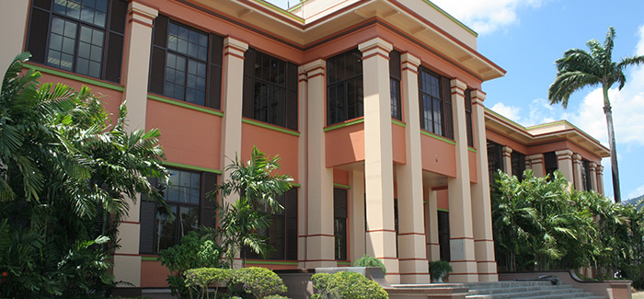
Changing Organizational Culture: The Role of Administrators in Transforming The UWI [The Case of UWISTA]

Slide 2
Structure of Presentation
The Context
The Organizational Culture of The UWI
Operationalizing Transformation- Strategic Initiatives
The Role of Administrators- Why we are relevant

Slide 3
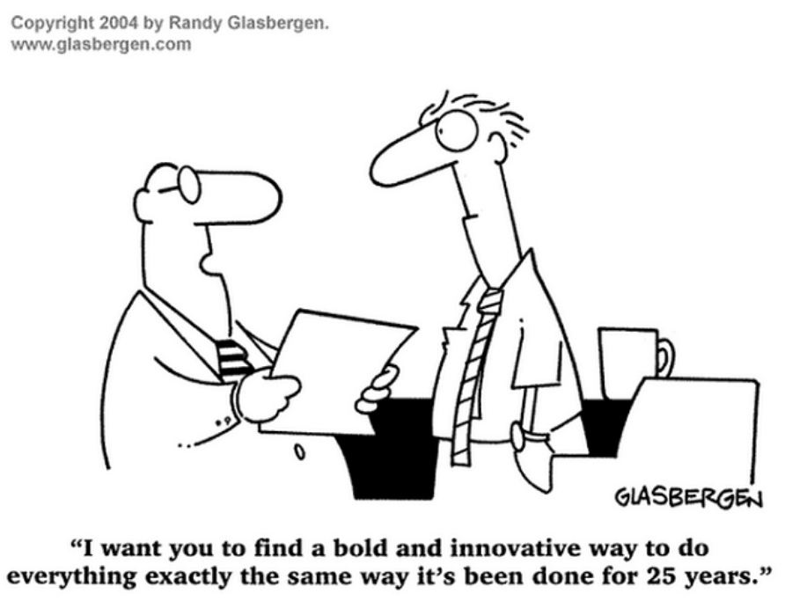
CONTEXT
Organizational Culture Impacts Performance and Effectiveness of Organizations
“From its inception, The UWI has been searching for an identity that is “consonant with West Indian sensibility and historical experience” (Nettleford 1986, p.9). .
Notes:
Dill (2012) has pointed out that in the current global context where many institutions are having greater autonomy over their internal affairs, the successful management of academic culture is crucial to the success of the university. Other theorists have also expressed the view that culture impacts organizational success, with the most notable among these perhaps being Cameron and Quinn (2006), who conclude that “…organizational culture has a powerful effect on the performance and long-term effectiveness of organizations.” (p.5). In the case of UWISTA therefore this suggests it is important not only to define the organizational culture but also to determine how best to manage it to achieve objectives.

Slide 4
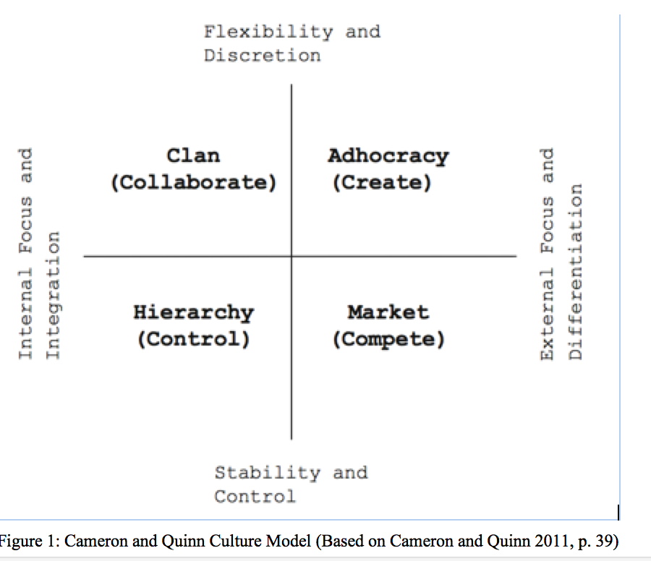
DEVELOPING A PROFILE OF ORGANIZATIONAL CULTURE
Clan Culture
The environment is a friendly, collaborative (Like a family). Leaders are considered mentors, and collaboration and loyalty to the organization are critical.
Adhocracy Culture
The focus is on creativity and dynamism. Leaders are seen as innovators and leaders and employees are risk takers.
Market Culture
The focus is on results and goal achievement. People are competitive and leaders are hard taskmasters with high expectations of staff. Reputation and success are critical.
Hierarchy Culture
A highly structured work environment, where rules and formal procedures guide activities. Leaders encourage efficiency-based organization.
Notes:
Cameron and Quinn (2006) offer a tool for developing a profile of organizational culture, called the Organisational Culture Assessment Instrument (OCAI), which is based on the Competing Values Framework (CVF) developed by Quinn and Rohrbaugh (1983). To arrive at the CVF, Quinn and Rohrbaugh (1983) analysed a list of 39 indicators that represented possible measures of organizational effectiveness. Out of this statistical analysis they derived two major dimensions and organized the indicators into four main clusters. The two dimensions were: 1) Internal focus and integration or external focus and differentiation and 2) Stability and control or flexibility and discretion. These competing values were used to develop a matrix and from this the CVF emerged, with each quadrant corresponding with four organizational culture types represented in Figure 1.

Slide 5
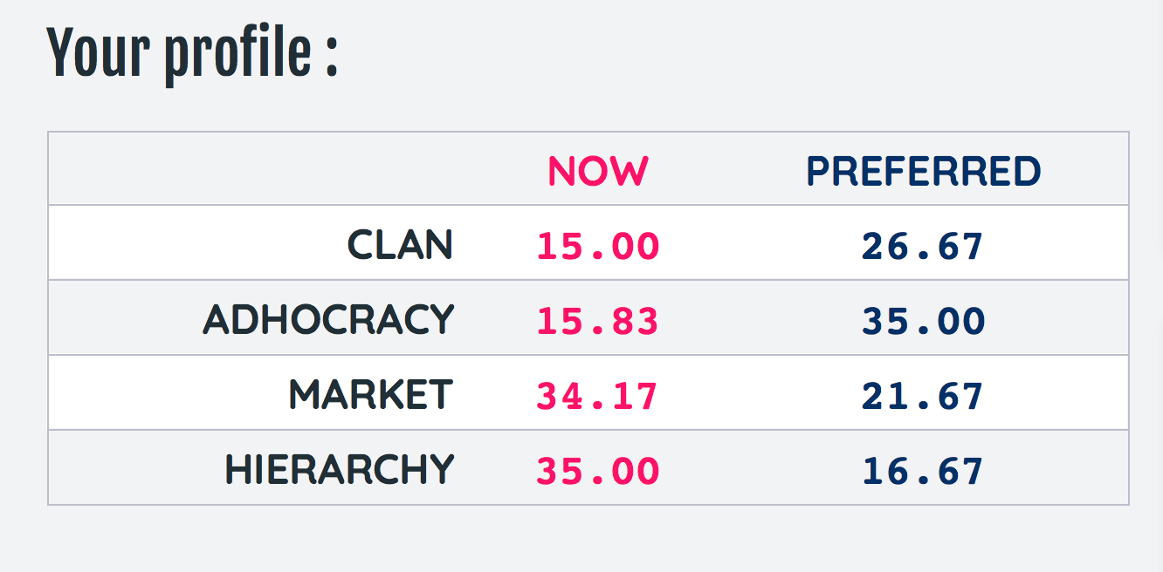
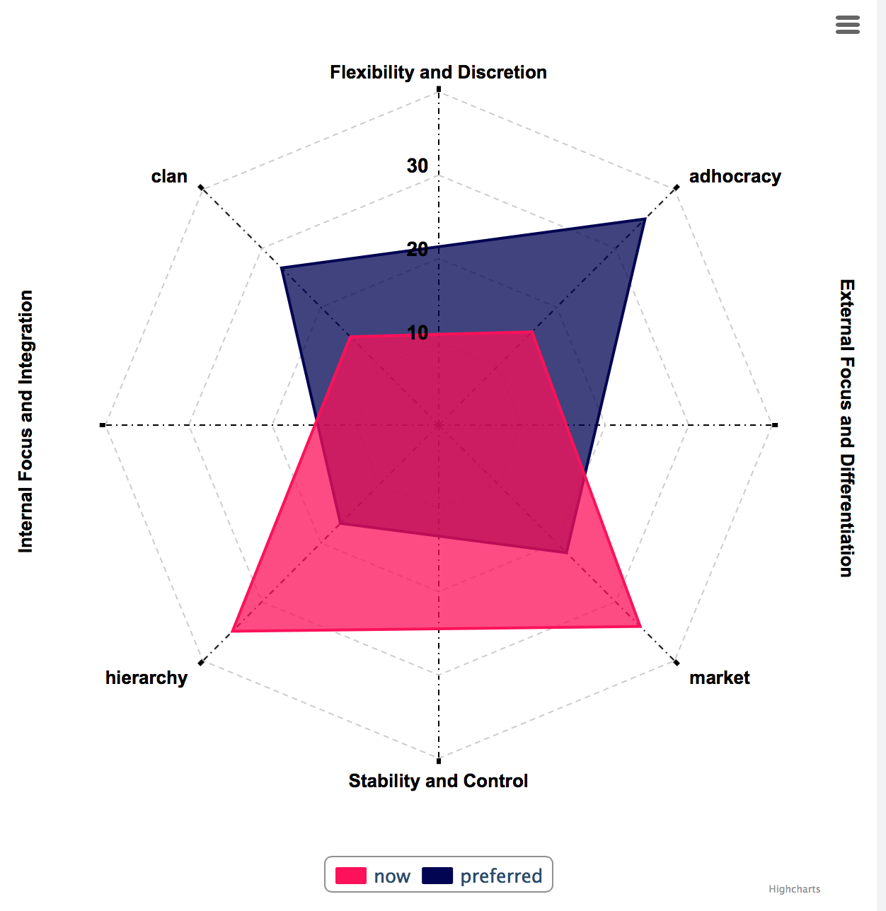
THE ORGANIZATIONAL CULTURE OF THE UWI FROM THE AUTHOR’S PERSPECTIVE USING THE COMPETING VALUES FRAMEWORK (CVF)
Notes:
https://www.ocai-online.com/about-the-Organizational-Culture-Assessment-Instrument-OCAI/OCAI-Assessment
The Organisational Culture Assessment Instrument OCAI developed by Cameron and Quinn (2006) is a 6-item questionnaire, which can be used to develop an organizational profile, which can be used to guide change management. The profile derived from the instrument provides a picture of the fundamental assumptions on which one’s organization operates and the values that characterize it. The OCAI was considered a useful tool to determine the organizational culture of the UWISTA, because of its widespread use and endorsement by several researchers (Suderman, 2012; Yu and Wu, 2009; Garman, 2006). Yu and Wu (2009) point out that the OCAI has several advantages over other such tools. It has few dimensions but broad implications; empirical validation in cross-cultural research; and it has one of the most succinct questionnaires.

Slide 6
A change is needed

Slide 7
A change is needed
The UWISTA has recognized that to achieve this goal of access, alignment and agility there must be “ cultural change and revitalization” (Copeland, 2018, p.4).
In order to operationalize transformation, key strategic initiatives have been premised on a vision that is encapsulated in six thematic areas:
1. Innovation and Entrepreneurship
2. Curriculum and Pedagogical Reform
3. Systems and Processes Review
4. Financial Model Review
5. HR Systems Review to bring about cultural change and revitalisation
6. Brand and Soul

Slide 8
What NEEDS TO CHANGE?
Change our current culture
Encourage the development of more creative thinkers and problem solvers, while stimulating collaboration & human resource investment
Administrators who occupy key positions in various layers of the organisation need to adapt and accept a role in driving change

Slide 9
Who are our ADMINISTRATORs
The Principal and Deputy Principal
Deans, and Heads of Departments
Registrars, Bursars, Senior Administrative Staff (connected to operational units) Other Categories of Professional Staff who also enjoy similar benefits are Information Technology (IT) professionals; Research Fellows; and Librarians.
Administrative support staff (Administrative Assistants, Office Managers within departments).
Notes:
Not exhaustive list

Slide 10
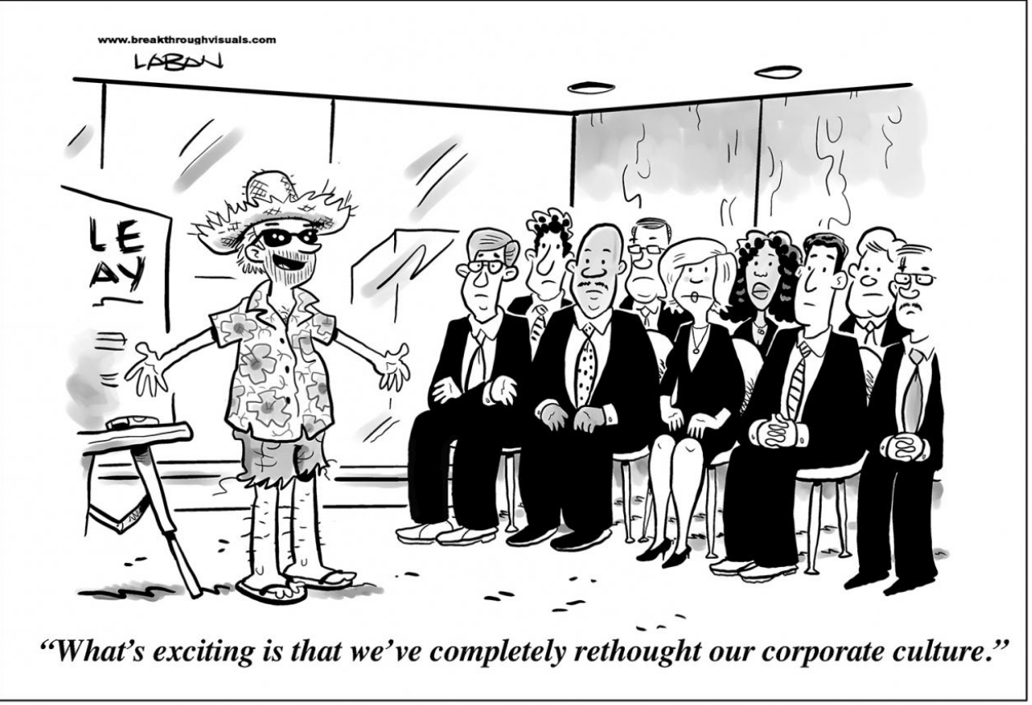
The Role and Relevance of Administrators
Function as good leaders and cope with inherent tensions of academic vs administrative roles.
Allow for more clan and adhocracy values to support the organizational change required,

Slide 11
The Role and Relevance of Administrators Cont’d…
Understand, participate in and encourage shared leadership- can reduce burden on some and develop others
Notes:
One of the areas where work will need to be done is with regard to the role of middle managers such as Heads of Departments, who now complain they are overwhelmed with administrative responsibilities. As noted by Thornton, Walton, Wilson and Jones (2018), supporting Heads of Departments to become more effective and to help support more distributive leadership may require strategies such as “reducing workload, providing learning and development programs, and clarifying the balance of professional and personal competencies” (p.208).

Slide 12
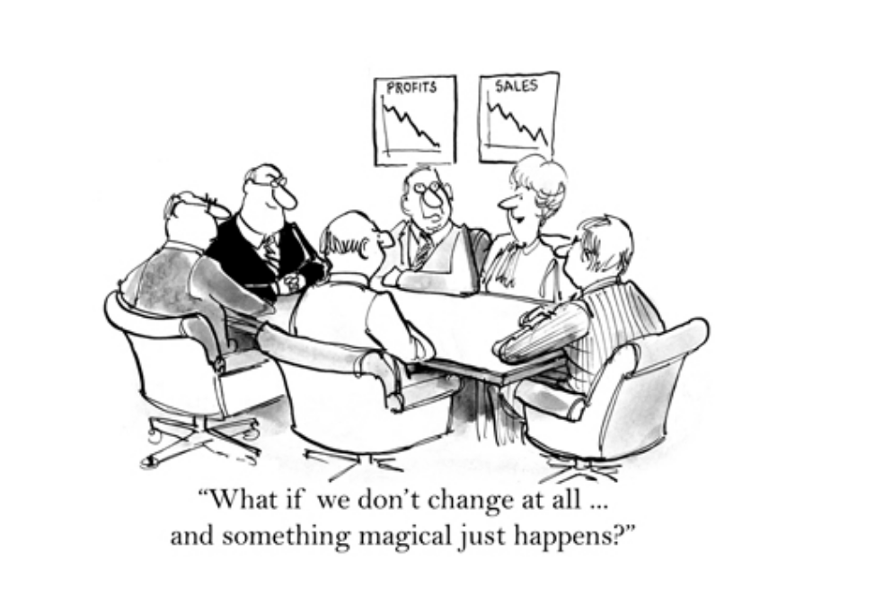
The Role and Relevance of Administrators Cont’d…
Drive the HR function to ensure the roles and competencies of hires reflect and reinforce the desired culture of the organization
Develop change capability
Notes:
Quinn and Cameron (2006) note specifically that the effective human resource manager must ensure that each of the four cultures are represented in the organization and more importantly, that the roles and competencies emphasized by the human resources department reflect and reinforce the desired culture of the organization. Goedegebuure and Schoen (2014) state the importance of talent development and specifically defining the skills, capacity, relationships and behaviours required of staff.

Slide 13
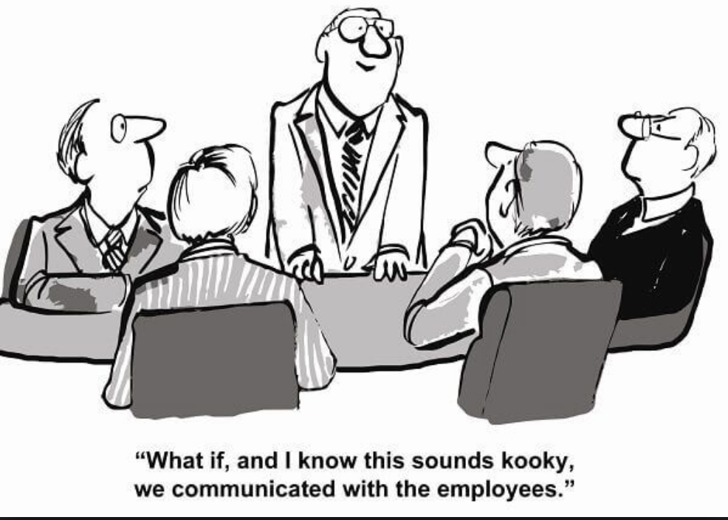
The Role and Relevance of Administrators Cont’d…
Develop change capability
The key areas identified by the organization for operationalizing the strategic plan need to be addressed
Get buy-in from all levels of staff for change to take place.
Notes:
Quinn and Cameron (2006) note specifically that the effective human resource manager must ensure that each of the four cultures are represented in the organization and more importantly, that the roles and competencies emphasized by the human resources department reflect and reinforce the desired culture of the organization. Goedegebuure and Schoen (2014) state the importance of talent development and specifically defining the skills, capacity, relationships and behaviours required of staff.

Slide 14
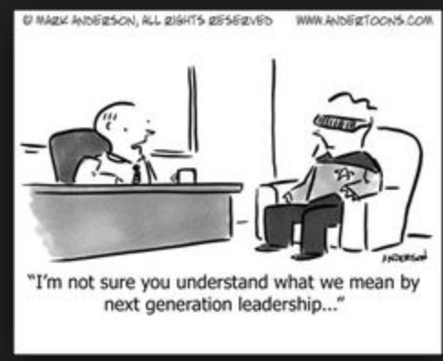
CONCLUSION
Need to be more strategic-starting with appropriate self-assessment.
adjust the human resource element in the organization to bring about cultural change and revitalization.
Roles and responsibilities of academic and non-academic administrators need to be clarified and rationalized
Notes:
The role of administrators should start with
appropriate self-assessment to gauge the actual internal and external environment.
There will also be a need to adjust the human resource element in the organization to bring about cultural change and revitalization.
Roles and responsibilities of academic and non-academic administrators need to be clarified and continuous, relevant professional development for administrators at all levels must be undertaken.
In order to get buy-in from staff, administrators in the role of leaders and operational managers, need to demonstrate specific attributes, which earn respect and loyalty, define governance and management structures and ensure there is credible, clear communication.
Most importantly, the institution needs to consider building change capability by perhaps setting up a dedicated unit or administrator to serve as change agent to implement and monitor change management.

Slide 15
CONCLUSION cont’d
relevant professional development for administrators at all levels
credible, clear communication.
building change capability -either through relevant individual staff or unit
Notes:
The role of administrators should start with
appropriate self-assessment to gauge the actual internal and external environment.
There will also be a need to adjust the human resource element in the organization to bring about cultural change and revitalization.
Roles and responsibilities of academic and non-academic administrators need to be clarified and continuous, relevant professional development for administrators at all levels must be undertaken.
In order to get buy-in from staff, administrators in the role of leaders and operational managers, need to demonstrate specific attributes, which earn respect and loyalty, define governance and management structures and ensure there is credible, clear communication.
Most importantly, the institution needs to consider building change capability by perhaps setting up a dedicated unit or administrator to serve as change agent to implement and monitor change management.

Slide 16
Author: Dr Dianne Thurab-Nkhosi, The University of the West Indies,

