Slide 1

Bridging the Divide between Administration and Academia
Presenters: Denise Stephenson-Hammil
Michelle Holness

Slide 2
Presentation Outline
Methodology
Introduction
Research Objectives, Questions and Responses
Planning and Development Department
  Planning
  Institutional Research
  Projects
Recommendations

Slide 3
Methodology
Descriptive case study utilizing the following data collection methodologies:
Focus Groups – A guided facilitation of conversation covering important information required. This was completed with two groups, one each from Administration and Academia, using pre-determined questions as guidelines.
Key Informant Interviews - These were deliberately not very structured. Interviews were held separately with three key informants in which a dialogue was established and the issues explored.
Document Review – Analysis was done of existing documentation on the functional areas in the Planning and Development Department. Feedback from the focus group interactions and the interviews were also carefully noted and incorporated.

Slide 4
Introduction
Higher Education institutions are complex entities with many moving parts. Their success depends on how well these parts are designed and manage to work together to achieve agreed goals. These moving parts may be grouped into two broad categories: Administration and Academia.
Institutions frequently experience division along these lines, which dissipates some of their energy and resources which could otherwise be engaged in harmonious productive enterprise.

Slide 5
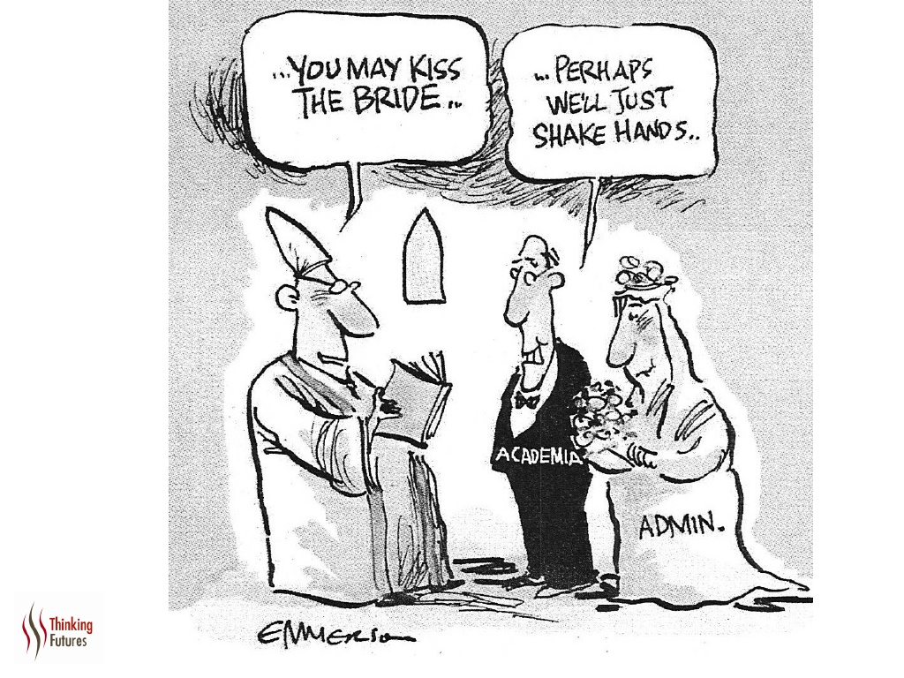

Slide 6
The “Divide” – Fact or Fiction
Is this great divide an immutable fact, or pure perception? The truth is most likely a combination of reality and perception.
We are reminded of the truth of the statement, “A house divided against itself shall surely crumble”.
This presentation lays out the evolutionary path taken by the Planning and Development Department in an attempt to create value for the University by providing Academic and overall institutional support of a truly significant nature, that could be deemed a unifying force in the institution.

Slide 7
The Research Objectives are:
To identify issues which cause or create a divide between Administration and Academia.
To examine the effects of these divisive issues on the Institution

Slide 8
The Research Questions
Define the relationship between Administration and Academia
What are the causes of the divide?
3. What are the effects of the divide on the Institution?
4. Can the relationship be fixed? (repairing the bridge). If so, how?

Slide 9
Q1: The relationship defined
Tense
Frustrating
Not smooth
“Not much of a relationship”

Slide 10
Q2: What are the causes of the divide between Administration and Academia?
Administrators’ Responses:
Lack of communication i.e. conflicting, unable to see eye to eye and lack of clarification on the path to be taken to achieve desired outcomes.
Role segregation.
Policies implemented not being enforced.
Inadequate resources to assist in the achievement of desired outcomes at a given standard.
Insufficient recognition of the primary role of the academic staff.
The tendency in the faculties/colleges to be self-absorbed at times to the detriment of the bigger picture.
Appreciation of the functions and impact that each role has on the delivery of the product.
Lack of accountability.
Strategic and operational planning not generally known and accepted.

Slide 11
Q2: What are the causes of the divide between Administration and Academia?
Academia’s Responses:
Lack of and conflicting information
Lack of respect
Upward mobility of Administrative staff in the faculties/colleges stunted
Lack of appreciation of each individual/ group’s role
Leadership
Lack of accountability
Inefficiencies
Inequality of spread of resources
Silos
Organisational structure

Slide 12
Q2: What are the causes of the divide between Administration and Academia?
Key Informants Responses :
Administration’s primary focus – organizational effectiveness and
Academia’s – Academic quality. Improper alignment
No clear separation of responsibilities based on qualification and expertise
Lack of communication.
Unresponsiveness-issues not resolved in a timely way.

Slide 13
Q2 cont’d: What are the causes of the divide between Administration and Academia?
UTech, Ja. did not develop a strong academic culture from C.A.S.T.
times since lecturers were part-time only then and the administrative
staff was full-time. The full time culture was not engaged in the way
that it should have been. Needed a culture shift.
The feeling that administrative staff is policing academic staff in
telling them what to do in terms of their responsibilities.
Administrative and academic staff have similar qualifications e.g. Masters degree and administrative staff have limited scope for promotion.
Lack of accountability e.g. grades not on the system.
Lack of access to records which should be easily accessible and having to engage third party.

Slide 14
Q 3: What are the effects of the divide?
Low staff morale. Some Admin. staff felt like they were looked down on by Academia.
University losing pride of place.
Reduction in quality of education.
Standards slipping.
Poor staff morale and interest.
Compromised quality of the product.
Poor opinion of the product being produced.

Slide 15
Q 3: What are the effects of the divide?
Not living up to the university’s core values
Lack of unity
Low staff morale
Poor customer service - Student experiences many times are disappointing and so they are eager to leave institution.
Inefficiencies
Poor perception of Institution

Slide 16
Planning and Development Department

Slide 17
Evolution of Planning at UTech, Jamaica
The integrated planning function at the institution began first via a Task Force as a means of overseeing the transition from College to University.
A sustained period of highly participatory deliberations among senior academics and administrators led to the development of the first Strategic Plan (1998-2002).
The Planning and Project Development functions were formalized in 2004 with the establishment of the Planning and Development Department.

Slide 18
Hindrances to the effectiveness of the Planning Process
Inadequate implementation of the Integrated Planning Process at the Division/Faculty levels and below.
Inadequate information on the University’s operations to effectively guide decision-makers.
Inadequacy of the requisite foresight/skills in implementing plans and making them a reality.
Insufficient teamwork and group dynamics that give primacy to goal accomplishment

Slide 19
Hindrances to the effectiveness of the Planning Process
Inconsistent allocation of human and material resources among organizational units against operational objectives. (This points to inadequate integration of the budgeting and planning processes)
Inadequate intra-organizational communication capability at all levels and between all operational units.
Organizational culture not keeping pace with organizational changes and new direction.
Planning culture not sufficiently permeated throughout the organization
Inconsistencies in championship of the process by institutional leaders

Slide 20
Enhancements to the Planning Process
A system of mining data from internal databases, analyzing the data and generating pertinent reports.
Incorporation of Labour Market, outcome and impact analyses.
An expanded stakeholder analysis system to identify, assess and prioritize their needs and analyze the University’s ability to meet the needs
An institutionalized system for stakeholder consultation to systematically organize input and involvement in the Planning Process.

Slide 21
Planning as a bridging mechanism
Engagement of University constituents including Administrators and Academics during all phases of the process
Clear understanding and articulation of roles and responsibilities and attempt to engender respect for the different roles
Alignment of accountability with responsibility
Emphasize focus on “one University” in order to eliminate silos

Slide 22
The importance of data to HEIs
Regional governments have become increasingly concerned about the role and relevance of their respective higher education systems, institutions and policies
Financial pressures and the need for accountability have led to the following key requirements in higher education:
    A stronger emphasis on quality, efficiency, outcomes and “value for money”
    A greater demand for measurement and reporting

Slide 23
The importance of data to HEIs
The wider community is increasingly seeking reliable information to assess the quality of higher education institutions in order to make more meaningful comparisons and informed choices
In the Education sector generally, there is continuing interest in statistics as a means of developing performance indicators which provide quantitative measurement for assessing performance.

Slide 24
The importance of data to HEIs
These statistics can be employed at different levels to add value:
  System or Sector
  Institution
  Programme/discipline
At each level, reliable statistics can aid
  assessment and guide decision making

Slide 25
The importance of data to HEIs
In higher education, statistics are particularly useful as:
  An aid to institutional management
  A mechanism for resource allocation and/or government monitoring
  A basis for national and international comparison (sectoral or institutional)

Slide 26
Stakeholders – HEI Data/Statistics
There are several audiences (stakeholders) for statistics in higher education, each with particular purposes, needs, and use:
  Governments
  Higher education institutions
  Funding agencies (development partners)
  Employers
  General Public

Slide 27
AUDIENCE | PURPOSE
Government | Accountability, performance assessment
 | Policy and planning in higher education
 | Allocation of resources
 | Funding
 | Value of investment
 | Manpower planning
Institution | Internal management: data-driven decision making
 | Comparison with other institutions
 | Marketing, Image building
 | Evaluation of teaching and research activities of individuals and departments
Public | Accountability,
Students | Institutional quality, choice of institution/programme
Industry | Partnership (e.g. research funding), grant aid

Slide 28
Office of Institutional Research (OIR)
OIR established in 2009 in the Planning and Development Department

Slide 29
Office of Institutional Research
Through the Office of Institutional Research (OIR), the University has developed a robust system of data collection.
This is done primarily through the utilization of both internal and external sources which factor keenly into the decision making process at UTech, Jamaica.
Surveys are routinely conducted to gauge the pulse of the institution and the response its operations elicit from its major stakeholders, especially students.

Slide 30
Office of Institutional Research
With the integration of data from the institution’s various databases, a custom system was developed to monitor and track students academic performance at varied levels in a relatively short time.
Indicators are monitored at the institution, faculty/college, programme and even individual level.
These have been used to primarily influence policy, assess courses of study and develop programmes to assist students in weak areas.
The IR Unit is currently examining software that may be able to predict students performance, student awards and so on.

Slide 31
Office of Institutional Research
UTech has developed user-friendly ways of sharing statistics, data, reports, etc. with internal stakeholders
This user-friendly method incorporates the use of dashboard technology to view various statistical and institutional reports.
It involves using a combination of advanced software and data obtained from any of our databases to build custom views that are tailor-made for each user or categories of users.

Slide 32
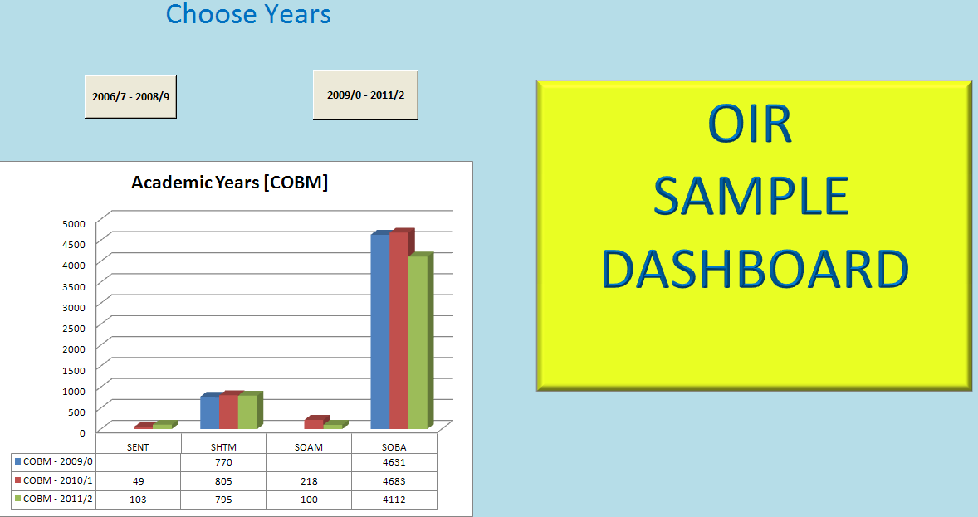
Dashboard example

Slide 33
Benefits of Institutional Research
Establishing an Institutional Research Unit has enhanced UTech’s ability to:
  Foster a data-driven and fact-based decision making culture
  Centralize the reporting and monitoring of strategic objectives in real time
  Generate intuitive and non-intuitive reports
  Inform policies and develop guidelines
  Influence Government’s policy development and planning in higher education

Slide 34
Projects Unit
Responsibilities:
Assessing developmental needs identified under Planning,
formulating proposals for funding,
collaborating with external (government/funding) agencies and central administration in seeking funds,
managing the implementation of developmental projects and
coordinating/collaborating with the University community as required at all stages of these processes.

Slide 35
Role of the Projects Unit in implementation of the UTech Enhancement Project
This project assisted the Government of Jamaica (GOJ) to achieve its tertiary education enrolment targets by enhancing the capacity of Utech, Ja. to increase the provision of quality tertiary education.
The project comprised two main components: Building and Civil Works; and Institutional Strengthening.
The Building and Civil Works component of the project provided for construction of classrooms, lecture theatres, and upgrade of labs.

Slide 36
Institutional Strengthening
Improvement of the Information and Communications Technology resource-use through the development of plans to meet academic and operational requirements, and the increased infusion of technology in teaching and learning;
Training: supported staff development in several areas; including classroom teaching, greater use of reflective teaching practices, as well as long-term training in specified areas;
An Academic Quality Audit System
Development of income diversification strategies, and strengthening the capacity to manage business development and consultancy services;
Improvement of programme relevance through the conduct of a Market Needs Analysis among employers and the conduct of a Graduate Tracer Study; and
Improvement of Human Resource Management capacity.

Slide 37
Project Issues
Re Building and Civil Works
Inefficiencies in the processes required for and during implementation
Readiness to implement the project as designed at inception
Accuracy of Documentation
Consultants’ suitability
Role of government entities/Agencies e.g. Fiscal Space restrictions
Project management/coordination

Slide 38
Lessons learnt
Vital importance of communication. A mechanism was needed to collaborate and share information about the project. Feedback was needed from stakeholders at every stage and resources should have been made available to encourage, record and listen to their contribution.

Slide 39
Lessons learnt
UTech, Ja. Stakeholders seemed to have operated in silos. This might have been due to lack of initial stakeholder awareness or engagement that was needed to facilitate buy-in.
This lack of a cohesive approach contributed to many delays as persons and departments operated independently of the other and with seeming self-interest.

Slide 40
Recommendations – Bridging the divide
Recognition that both arms are necessary for institutional survival
Respect for each other’s role
Understanding of each other’s role (indepth orientation needed)
Align accountability with responsibility
Eliminate silos – focus on one University; one vision

