Slide 1

Walking the Tightrope of Mental Health
Workplace Incivility and Mental Health:
Implications for both direct and indirect victims
Presenter: Afiya Jules, UWI St. Augustine Campus

Slide 2
HEALTH
Complete Physical
Mental
Social
Not merely the absence of disease or infirmity
Well-being

Slide 3
MENTAL HEALTH
Cognitive
Behavioral
Emotional
Well-being

Slide 4
GOOD MENTAL HEALTH
Manage life stresses
Contribute productively at work and in their communities
Realize their potential

Slide 5
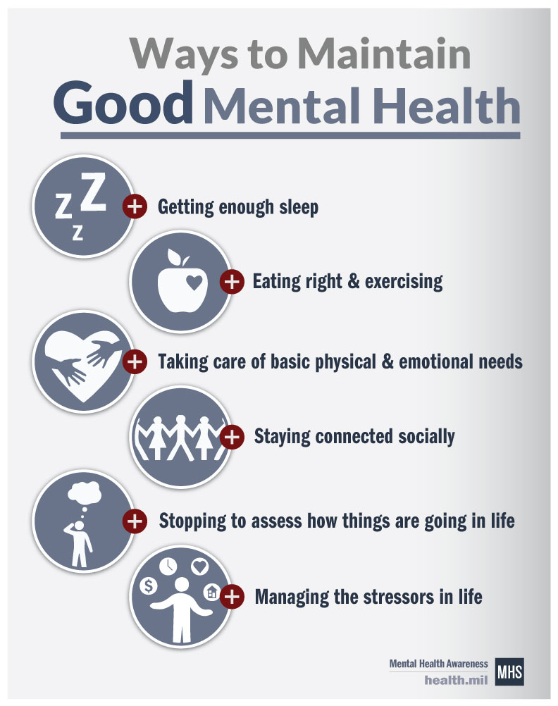

Slide 6
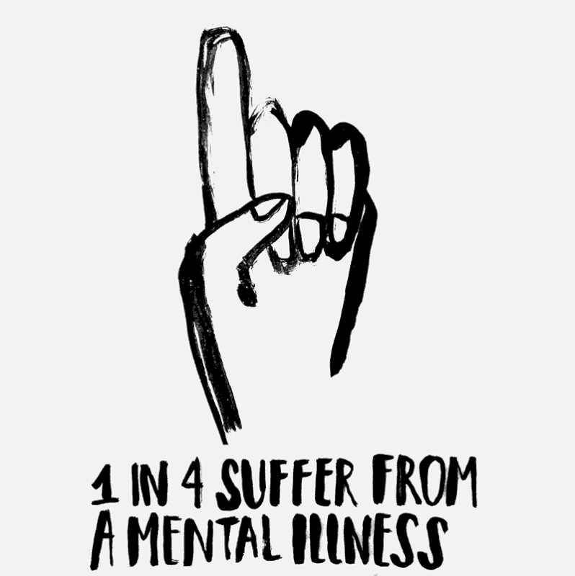
MENTAL ILLNESS

Slide 7
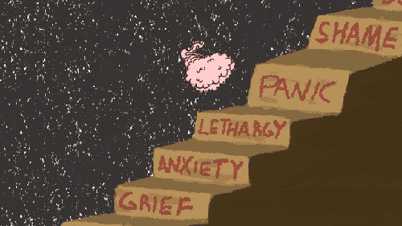

Slide 8

Depression – The most common mental illness
Affecting approximately 300 million people worldwide

Slide 9
REGIONAL CONTEXT
General Perspective
Addressing the Stigma
Social Stigma
Discrimination wrt:
  work
  access to healthcare
  housing
  the legal system
  family life
Mental health services
Primary care system
Removal of mental health stigma

Slide 10
WARNING SIGNS OF MENTAL ILLNESS
Mood changes
Withdrawal
Drop in functioning
Problems thinking
Increased sensitivity
Apathy
Feeling disconnected
Illogical thinking
Nervousness
Unusual behavior

Slide 11
WAYS TO MITIGATE MENTAL ILLNESS
Psychosocial support
Therapy
Medication

Slide 12
WHAT ARE WE DOING?
The University of the West Indies was instrumental in:
The development of mental health policies
Mental health consultations within the region
Provides in-service training to health professionals in primary healthcare
Provides a vessel for research and development which offers the possibility to advance and assess new ways of preventing and treating mental disorders

Slide 13

HIGHER EDUCATION STAFF

Slide 14


Workplace Incivility is significantly associated with Mental Health issues
Workplace Incivility
Mental Illness

Slide 15
WORKPLACE INCIVILITY
  Mild form of negative interpersonal behaviour
  Violates workplace norms
  Characterised by rudeness and disrespect
  Intentionally ignored
  Undermined by colleagues or publicly belittled by an insensitive manager

Slide 16
COUNTERPRODUCTIVE WORKPLACE BEHAVIOURS CONTINUUM

Slide 17
HEI REPORT
Employee Assistance Programme (EAP) reported cases of:
Bullying
Harassment
Victimisation
Humiliation
Verbal Aggression
Intimidation
Discrimination

Slide 18
TYPES OF INCIVILTY
Experienced
Witnessed
Instigated
Cyber
Incivility

Slide 19
FACTORS THAT ENCOURAGE WORKPLACE INCIVILITY
Enablers
Fear
Rage
Motivators
Job uncertainty
Competition among staff
Triggers
Poor communication
Lack of competence
Job cuts
Long working hours
Expected benefits
Dissatisfaction
Power
Lack of knowledge
The environment

Slide 20
IMPLICATIONS FOR BOTH DIRECT AND INDIRECT VICTIMS
Targets/Perpetrators
Organisations
Witnesses
Disengagement
Lack of Morale
Feeling disconnected
Feeling withdrawn
Lack of job involvement
Regressions in mental health
High turnover
Absenteeism
Low productivity
Decreased bottom line (Cost)
Regressions in mental health and job satisfaction
Profound levels of anxiety

Slide 21
COST OF INCIVILITY
$12 million a year in losses – study conducted by CISCO Co.
$300 billion in losses due to job stress and disengagement

Slide 22
RECOMMENDATIONS
Workplace Incivility
Mental Health
Training
Zero tolerance
Open and Transparent Communication
Self-checks
Provide a supportive environment
Introduce structural changes
Provide transparency
Provide clear and widely accessible information

Slide 23


THANK YOU
Contact:
: afiya.jules@gmail.com
: Afiya Jules

Slide 24
REFERENCES
Andersson, Lynne M, and Christine M. Pearson. 1999. “Tit for Tat? The Spiraling Effect of Incivility in the Workplace.” The Academy of Management Review 24 (3): 452–71. Vol. 24, No. 3
Crouch, R. (2018). Guidelines for Mental Health Promotion in Higher Education Prepared by the Universities UK/GuildHE Committee for the Promotion of Mental Well-being in Higher Education. Retrieved from http://www.hse.gov.uk/stress/standards/
Mascayano, F., Tapia, T., Schilling, S., Alvarado, R. N., Tapia, E., Lips, W., & Yang, L. H. (n.d.). Stigma Toward Mental Illness in Latin America and the Caribbean: a Systematic Review. https://doi.org/10.1590/1516-4446-2015-1652
Parekh, R. (2018). Warning Signs of Mental Illness. Psychiatric News. Retrieved from https://www.psychiatry.org/patients-families/warning-signs-of-mental-illness
Porath, C., & Pearson, C. (2013). The Price of Incivility. Harvard Business Review, (January-February 2013 Issue). Retrieved from https://hbr.org/2013/01/the-price-of-incivility
Richman, J. A., Rospenda, K. M., Nawyn, S. J., Flaherty, J. A., Fendrich, M., Drum, M. L.,… Richman, J. (1998). Sexual Harassment and Generalized Workplace Abuse Among University Employees: Prevalence and Mental Health Correlates (Vol. 89). Retrieved from https://ajph.aphapublications.org/doi/pdf/10.2105/AJPH.89.3.358
University of the West Indies Mona (Abel, J., Kestel, D., Eldemire-Shearer, D., Sewell, C., & Whitehorne-Smith, P. (2012). The West Indian medical journal. West Indian Medical Journal, 61(5), 475–482. Retrieved from http://caribbean.scielo.org/scielo.php?script=sci_arttext&pid=S0043-31442012000500002
World Health Organisation. (2013). Mental Health Action Plan 2013-2020. Retrieved from https://www.who.int/mental_health/action_plan_2013/bw_version.pdf
World Health Organisation. (1946). Constitution of The World Health Organization 1. Retrieved from http://apps.who.int/gb/bd/PDF/bd47/EN/constitution-en.pdf?ua=1
World Health Organisation. (1946). Constitution of The World Health Organization 1. Retrieved from http://apps.who.int/gb/bd/PDF/bd47/EN/constitution-en.pdf?ua=1

